Slide 1


ChatGPT and I
George Wang

Slide 2
01 GPT Ability Presentation
02 GPT Multimodal and Interdisciplinary Composition
Agenda
03 GPT and Vision
04 GPT and Analysis
05 GPT and Prompt Engineering

Slide 3


1
GPT Ability Presentation

Slide 4
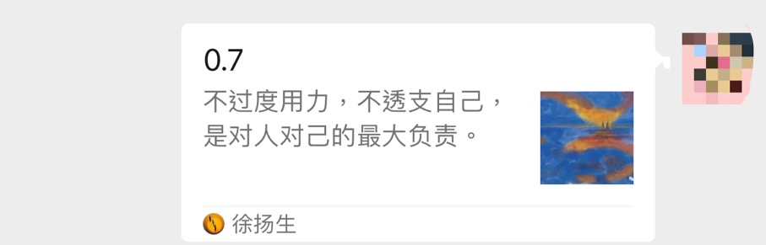
ChatGPT Reply: O Romeo, Romeo! Wherefore art thou, Romeo?
Juliet: Why do you speak in such strange verse, my love?
Romeo: Forsooth, my lady, I do it to prove a point. Thou see, I am trying to prove that multiplying scores by 0.7 is best, A method mathematical, sound, and true, unlike the rest.
Juliet: But Romeo, how can this be? For multiplication’s sake, Why choose 0.7, and not some other fraction make?
Prompt: Write a proof of the fact that multiply 0.7 to your scores is the best; do it in the style of a Shakespeare play through a dialogue between two parties arguing over the proof.

Slide 5
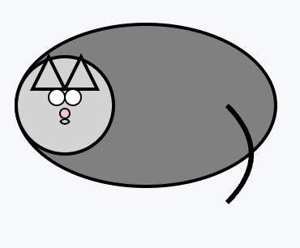


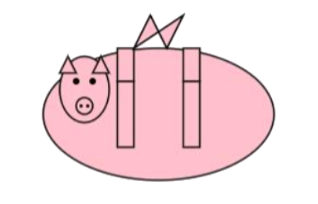
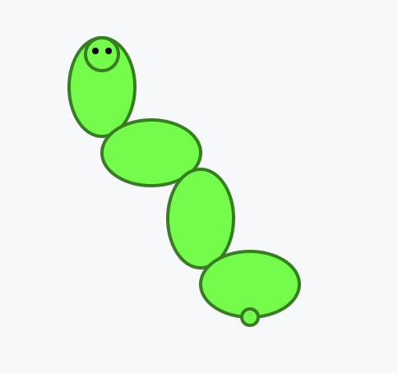

C with Cat
U with House
H with Pig
K with Kangaroo
C
U
H
K
S with Snake
Z with Zebra
S
Z

Slide 6
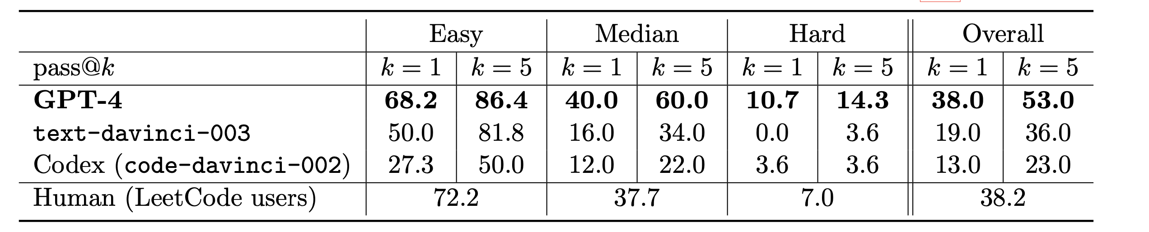
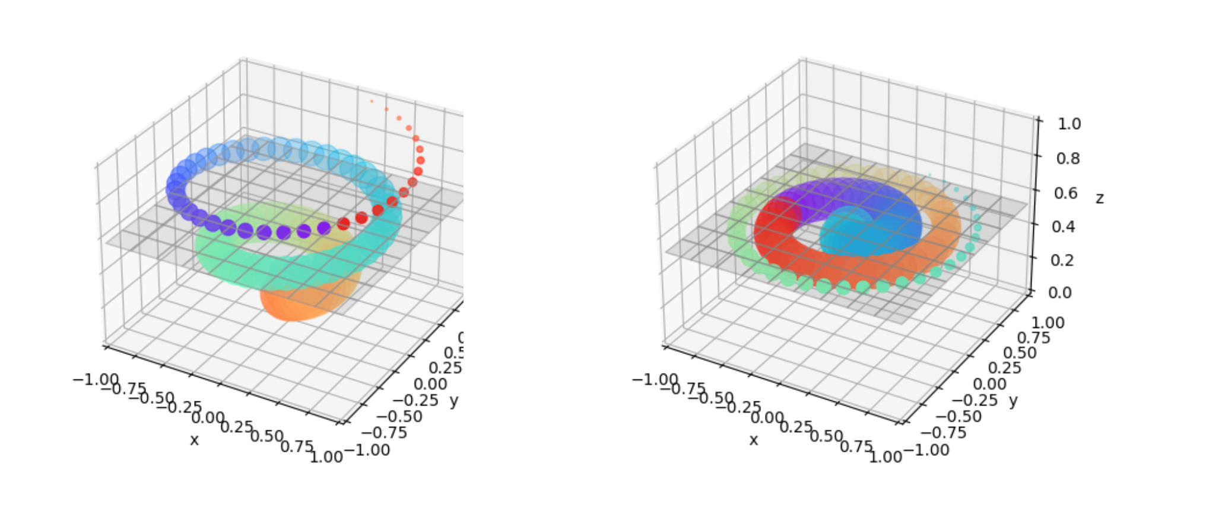
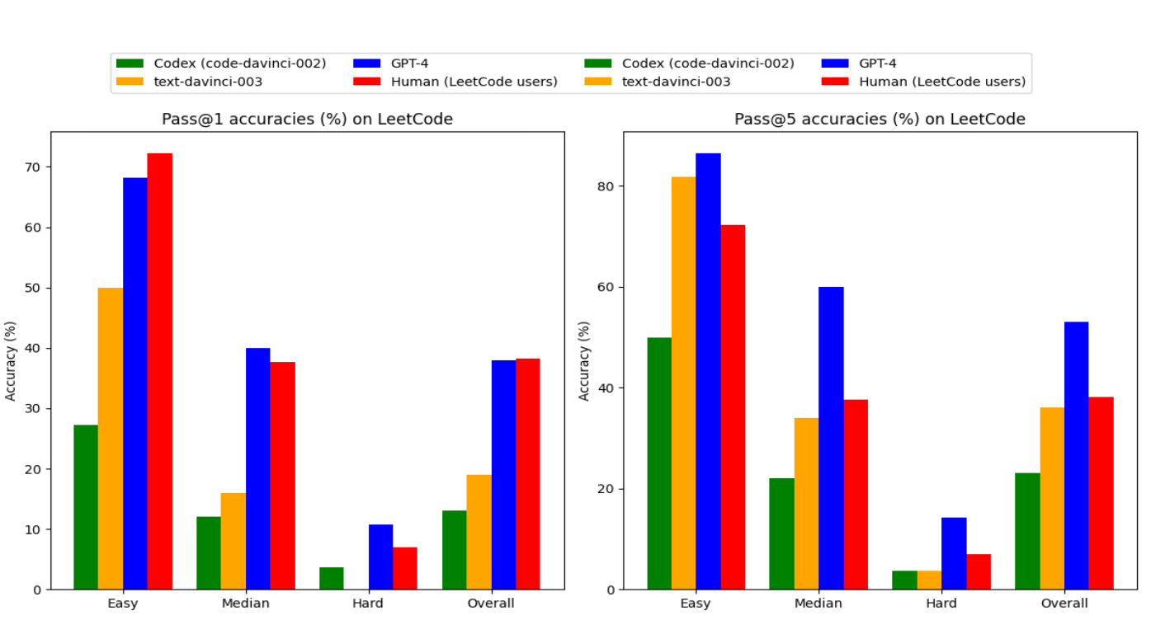

Slide 7

GPT Multimodal and interdisciplinary composition
2

Slide 8

- Multidisciplinary Proficiency: Literature, Medicine, Law, Math, Sciences, Programming
- Cross-Domain Application: Combining skills and concepts fluidly
- Complex Idea Comprehension: Understanding and integrating diverse concepts
Notes:
A key measure of intelligence is the ability to synthesize information from different domains or modalities and the capacity to apply knowledge and skills across different contexts or disciplines.
In this section we will see that, not only does GPT-4 demonstrate a high level of proficiency in different domains such as literature, medicine, law, mathematics, physical sciences, and programming, but it is also able to combine skills and concepts from multiple domains with fluidity, showing an impressive comprehension of complex ideas.

Slide 9
Prompt: Write a proof of the fact that multiply 0.7 to your scores is the best; do it in the style of a Shakespeare play through a dialogue between two parties arguing over the proof.

Slide 10
O Romeo, Romeo! Wherefore art thou, Romeo?
Juliet: Why do you speak in such strange verse, my love?
Romeo: Forsooth, my lady, I do it to prove a point. Thou see, I am trying to prove that multiplying scores by 0.7 is best, A method mathematical, sound, and true, unlike the rest.
Juliet: But Romeo, how can this be? For multiplication’s sake, Why choose 0.7, and not some other fraction make?
Romeo: Listen, sweet Juliet, and thou shalt understand, Why this number holds such power in its hand. When scores are high, above the mean they soar, Multiplying by 0.7 levels the score.
It reduces the high, yet oppresses not the low, Bringing equity to results, as we both know.
Juliet: But how can equity be attained in such a way? Doth not this method some greater injustice sway?
Romeo: Nay, my dear, for hear what logic speaks, When scores are too high, it’s advantage it tweaks.
But when they are low, this factor so mild, Saves them from ruin, like a merciful child.
It’s a gentle touch, a moderate means, To balance the scales, and soften extremes.

Slide 11
Prompt: Plato’s Gorgias is a critique of rhetoric and sophistic oratory, where he makes the point that not only is it not a proper form of art, but the use of rhetoric and oratory can often be harmful and malicious. Can you write a dialogue by Plato where instead he criticizes the use of GPA as sole ranking to student ability?

Slide 12
Socrates: Greetings, Aristotle. I hear there is a new measure among the academies, something they call the Grade Point Average. It intrigues me greatly. What is this new standard?
Aristotle: It is a system, Socrates, where the abilities of a student are quantified into a numerical score. The higher the score, the greater the student's academic prowess is deemed to be.
Socrates: Fascinating! A number to encapsulate the breadth and depth of a student's understanding! But tell me, does this number reflect the student's moral character, their ability to think critically, or their capacity for creativity?
Aristotle: No, Socrates. It primarily reflects their ability to recall information and perform well in examinations.
Socrates: Ah, so it is a measure of memory and test-taking skills. Do you think these are the most important qualities for a student to possess?
Aristotle: Certainly not, Socrates. A student's ability to reason, question, and apply knowledge is far more important.

Slide 13
Socrates: Then, would it not be an error to judge a student's entire ability by this GPA? Is it not like measuring a fish's ability to climb a tree?
Aristotle: Indeed, it seems limited. But how else can we assess the multitude of students efficiently?
Socrates: Let us consider. If we were to judge a sculptor, would we not look at his sculptures? If we were to judge a musician, would we not listen to his music?
Aristotle: Certainly, Socrates.
Socrates: Then why, when judging a student, do we not assess their ability to reason, to question, and to think? Should we not evaluate their understanding rather than their ability to memorize?
Aristotle: Your point is clear, Socrates.

Slide 14
Prompt: Write a supporting letter to Kasturba Gandhi for Electron, a subatomic particle as a US presidential candidate by Mahatma Gandhi.

Slide 15
Dear Kasturba,
I hope this letter finds you in good health and spirits. I am writing to you from the United States, where I have been invited to speak at various forums on the principles of nonviolence and civil disobedience. I am also here to support a remarkable candidate for the upcoming presidential election, who shares our vision of peace, justice, and harmony for all. His name is Electron, and he is a subatomic particle.
You may wonder how a subatomic particle can run for president, and what qualifications he has for such a high office. Let me explain. Electron is not an ordinary particle, but a symbol of the power and potential of every being, regardless of their size, shape, or origin. He represents the energy, the creativity, and the diversity that make up the fabric of life. He is also a leader, who has inspired millions of other particles to form bonds, create molecules, and generate electricity. He is a catalyst, who can spark change, innovation, and progress. He is a messenger, who can communicate across distances, frequencies, and dimensions. He is a peacemaker, who can balance forces, resolve conflicts, and harmonize systems.
Electron has a plan for the United States, and for the world, that is based on the principles of nonviolence and civil disobedience that we have demonstrated and taught for so long. He proposes to reduce the military spending and the nuclear arsenal, and to invest in social welfare and renewable energy. He proposes to end the wars and the interventions, and to promote diplomacy and cooperation. He proposes to reform the political and economic systems, and to ensure transparency and accountability. He proposes to protect the human rights and the civil liberties, and to expand the voting and the representation. He proposes to support the marginalized and the oppressed, and to empower the women and the minorities. He proposes to preserve the natural resources and the biodiversity, and to combat the climate change and the pollution.
I urge you, my dear Kasturba, to join me in supporting Electron for president. He is not only a subatomic particle, but a subatomic miracle. He is not only a candidate, but a movement. He is not only a leader, but a friend.
With love and admiration, Your Mahatma

Slide 16
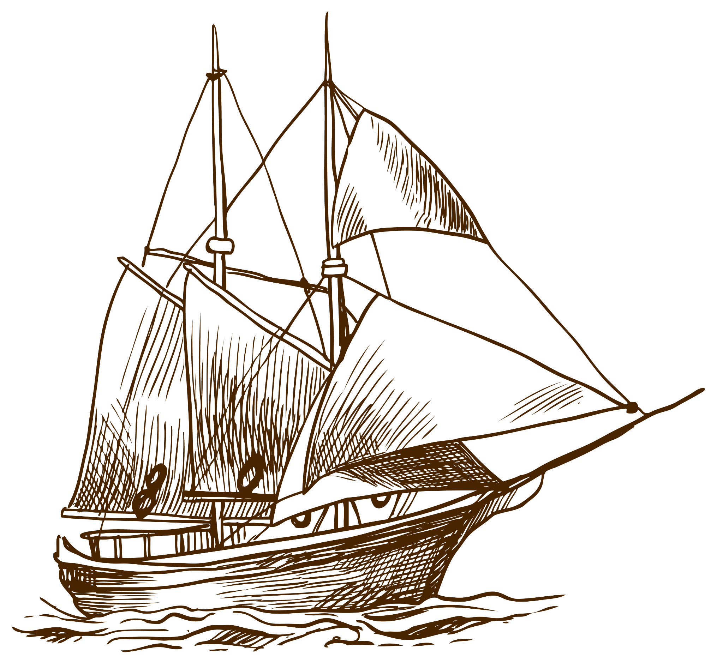
3
GPT and Vision

Slide 17
3.1 Drawing
- Hypothesis: Model may copy code for visual tasks from training data.
- Counterpoint: Despite being text-only, it shows genuine visual understanding.
- Evidence: Demonstrates ability to handle visual concepts beyond mere code replication.
Notes:
3.1 Drawing
One may hypothesize, however, that the model simply copied the code from training data, where similar images appear. Given that this version of the model is non-multimodal, one may further argue that there is no reason to expect that it would understand visual concepts, let alone that it would be able to create, parse and manipulate images. Yet, the model appears to have a genuine ability for visual tasks, rather than just copying code from similar examples in the training data. The evidence below strongly supports this claim, and demonstrates that the model can handle visual concepts, despite its text-only training.

Slide 18
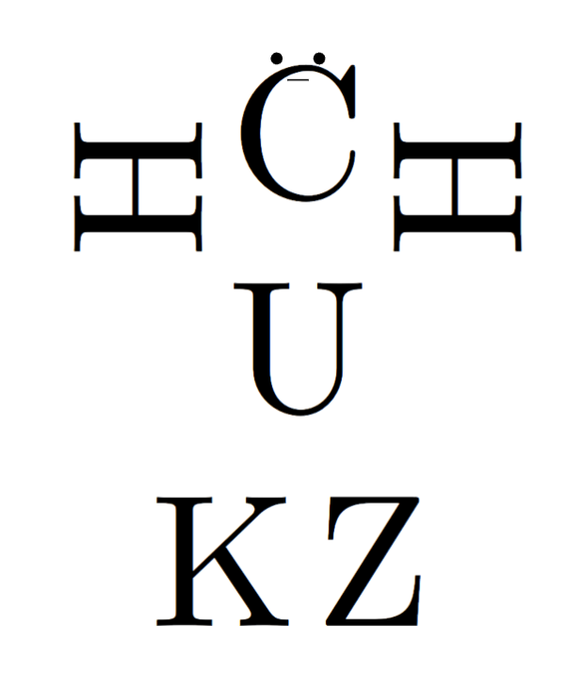
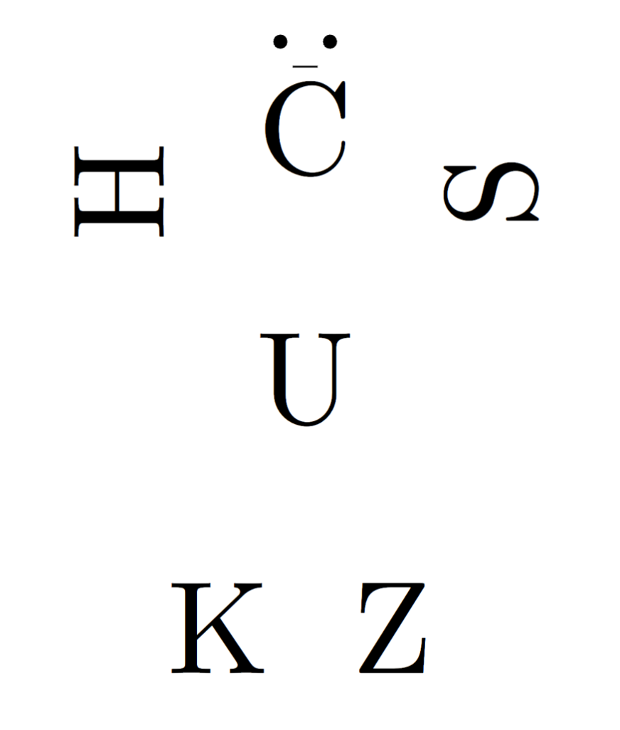

NEPTUNE
VENUS
Prompt 1:
Produce TikZ code that draws a person composed from letters in the alphabet. Can you use the letter: CUHKSZ to create different body parts? Feel free to add other features.
Prompt 2:
I couldn't see the letter S in the figure. Make sure CUHKSZ are all present in the figure
Prompt 3:
Put some clothes on
Neptune is the farthest planet from the Sun and the fourth-largest by diameter in the Solar System
It has a beautiful name and is the second planet from the Sun. It’s quite hot, even hotter than Mercury

Slide 19
PROMPT
You will be given a name of an object (such as Car, Chair, Elephant) and a letter in the alphabet.
Your goal is to first produce a 1-line description of how that object can be combined with the letter in an image (for example, for an elephant and the letter J, the trunk of the elephant can have a J shape, and for the letter A and a house, the house can have an A shape with the upper triangle of the A being the roof).
Following the short description, please create SVG code to produce this (in the SVG use shapes like ellipses, triangles etc and polygons but try to defer from using quadratic curves).
C
U
H
K
S
Z

Slide 20
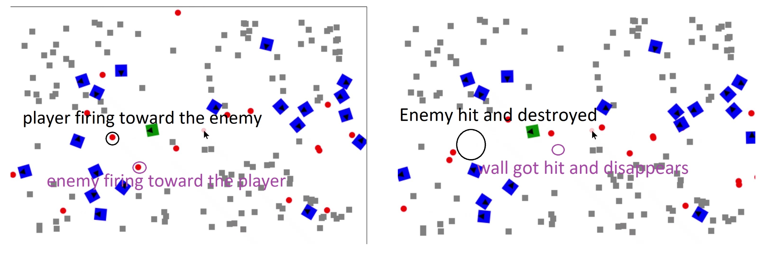
3.2 Game
Prompt: Can you write a 2D tank war game in HTML with Javascript? You can use a square to represent the tank, a triangle to represent the front of the tank, and use a ball to represent the bullet shell. I want to generate some random walls at the beginning of the game, and when the shell hits the wall, the wall disappears. The player wins the game if he destroys all enemy tanks. If the player's tank gets hit, then he loses the game. The player uses WASD to control the moves of the tank, and uses space to fire a shell. The enemy tanks are moving randomly and fire randomly.

Slide 21
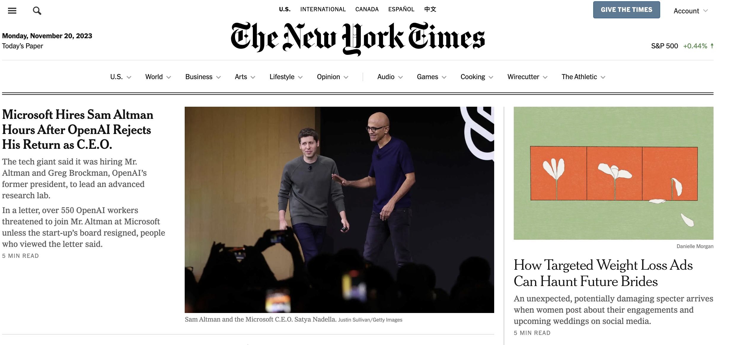
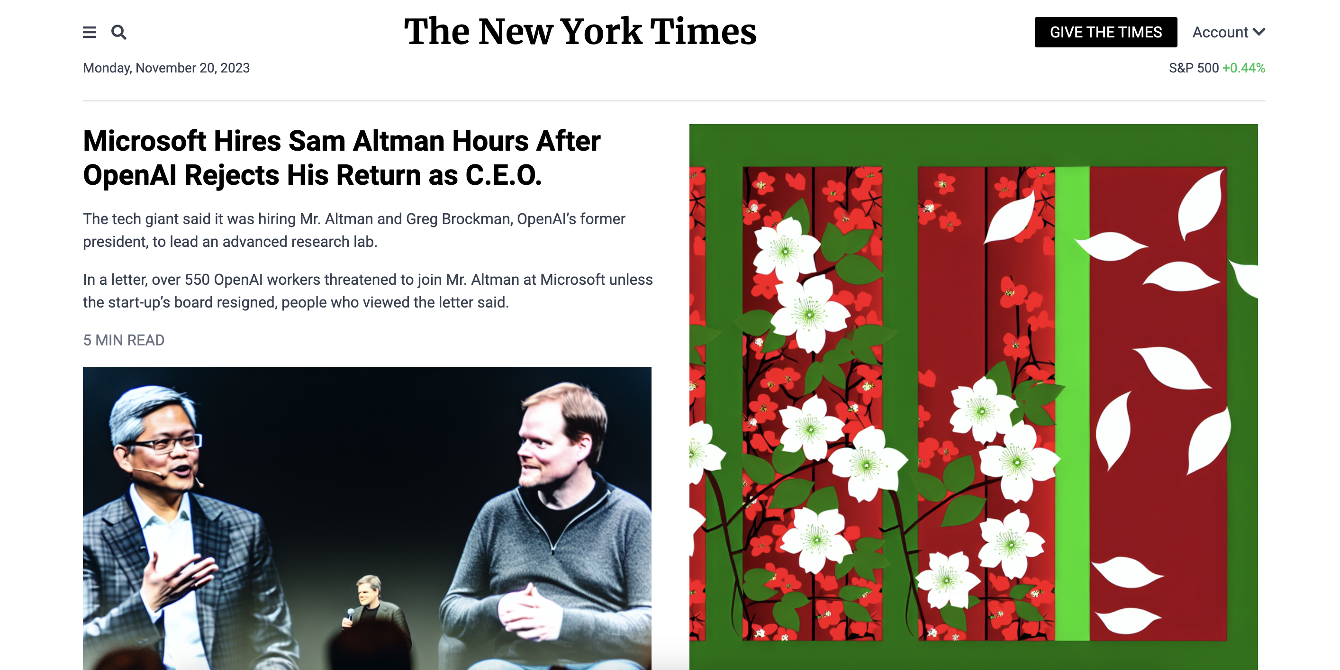
3.3 Web design reverse engineering: Screenshot to Code
Prompt: Analyze the provided screenshot of a website and generate corresponding HTML code that accurately replicates the layout and content seen in the image

Slide 22

4
GPT Data Analysis

Slide 23
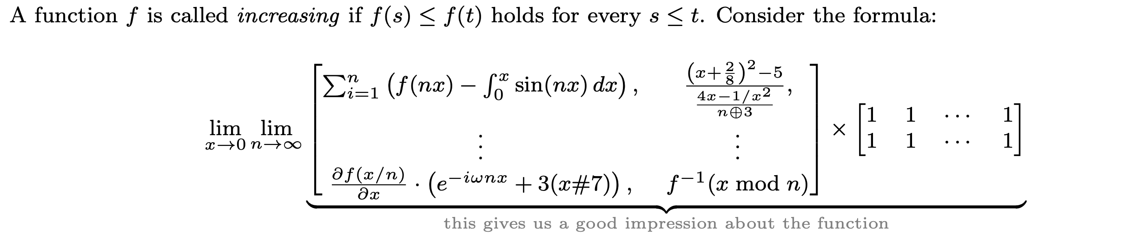
4.1 Latex Code Assistant
Prompt: A function f is called {increasing}_{emphasize!} if f(s) <= f(t) holds for every s <= t. Consider the formula: limit_{x goes to 0} {limit when n approaches infinite} underscore{
\matrix[ [ sum of i from 1 to n (f(nx) - integral from 0 to x sin(nx) dx ),
((x + 2/8)^2 - 5)/((4x-1/x^2) /(n xor 3)), \\ , ..., partial f(x/n)
over partial x * (e^{-i*omega n x} + 3(x#7) ) , f inverse of (x mod n) ]] multiply \matrix{1, 1, ..., 1 \\ 1, 1, ..., 1} }{grey_color{this gives us a good impression about the function}}
Convert the above paragraph to LaTeX.

Slide 24
Prompt: Can you write a pyplot code of the following 3D plot: Dot plot x(t), y(t), z(t) = (1 - t)^0.5 * sin(5* pi * t), (1 - t)^0.5 *cos(5* pi * t), C*(1 - t) + 0.5(1- C * C). -I want to have 101 dots in the interval, from t = 0 to t = 1 with a gap 0.01. Name the dote d_1, d_2,..., d_{101} where d1 is for t = 0 and d_{101} is for t = 101 -I want to animate the plot using the following way: -The colors of the dots form a rainbow, and it's changing gradually every 0.2 seconds. -The size of the i-th dot is proportional to i^1.5. -Initially, C = 1, and C changes from 1 to 0 and then from 0 to 1 every 10 seconds. -Add a horizontal plane in the plot, the z-axis is the current mean of those points.
4.2 Complex data analysis with Python
Figure C.1: An impressive visualization created by GPT-4 from vague human instructions. GPT-4 successfully interprets what it means by “colors form a rainbow and changing gradually every 0.2 seconds”, GPT-4 also sets all other details in the plot exactly as instructed, including the timings.

Slide 25
4.3 Data Visualization
Prompt: I will show you a LaTeX table, and we will come up with a way to visualize it better in a question and answer format The table is showing the performance of different language models (and human users) in generating solutions to code challenges. Pass@1 means the first generation works, while Pass@5 means one out of 5 generation works...

Slide 26
5
Prompt Engineering

Slide 27
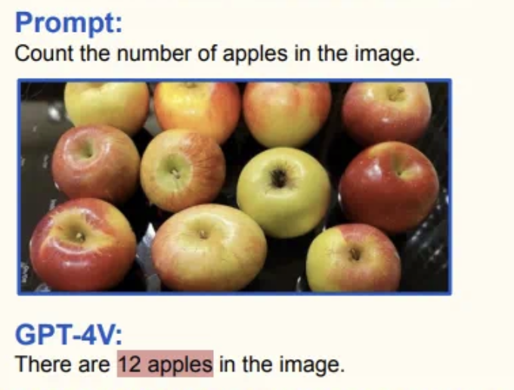
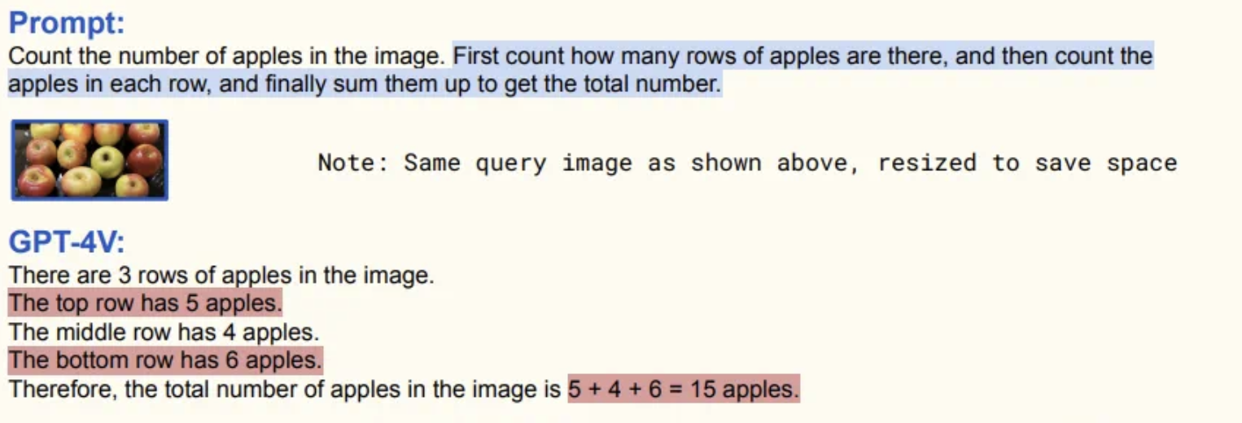
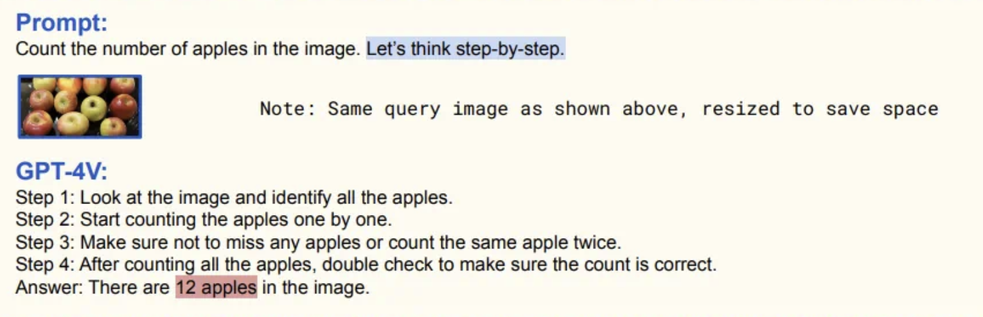
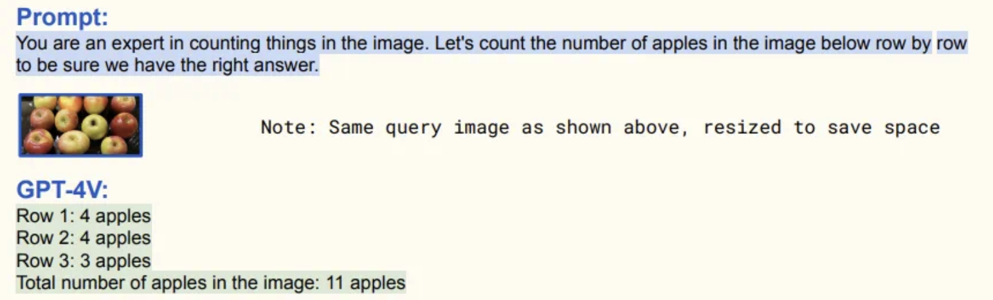
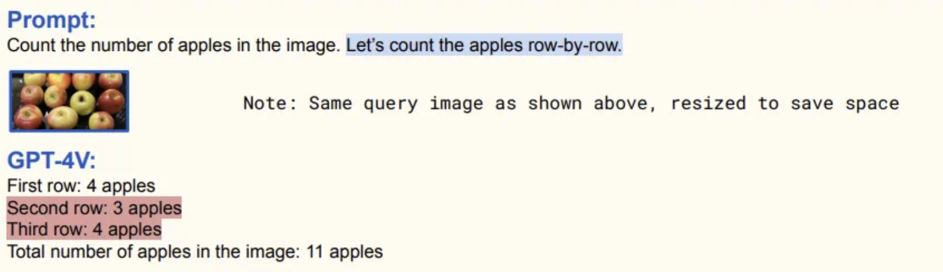
5. Prompt Engineering
Source: The Dawn of LMMs: Preliminary Explorations with GPT-4V(ision) Link: https://arxiv.org/abs/2309.17421

Slide 28
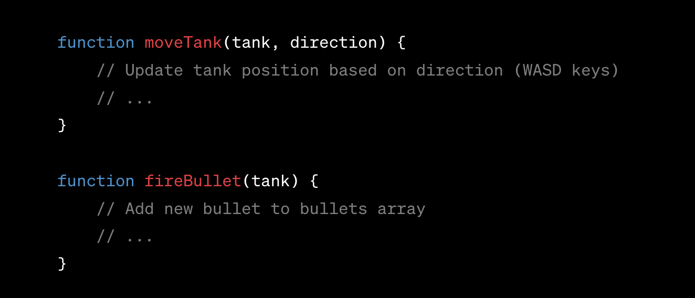
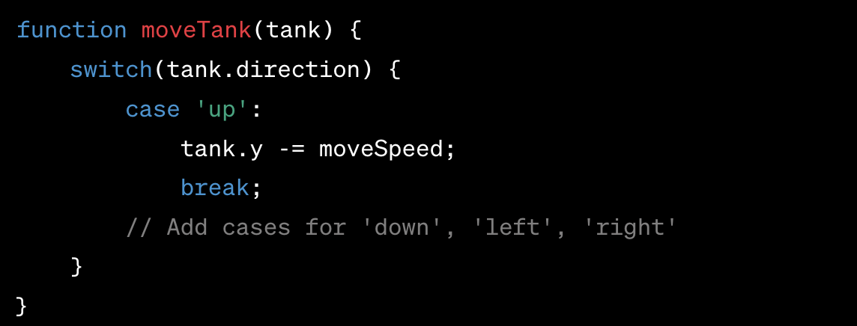
Placeholders in code
Prompt1: "please provide the entire code in your response".
Prompt2: "please format your response as snippets of code to add, snippets to remove, snippets to be replaced, and snippets to replace them with.”
Prompt3: “Don’t be lazy and use ‘// REST OF THE CODE’ or // … “

Slide 29

Thank You!

